Slide 1
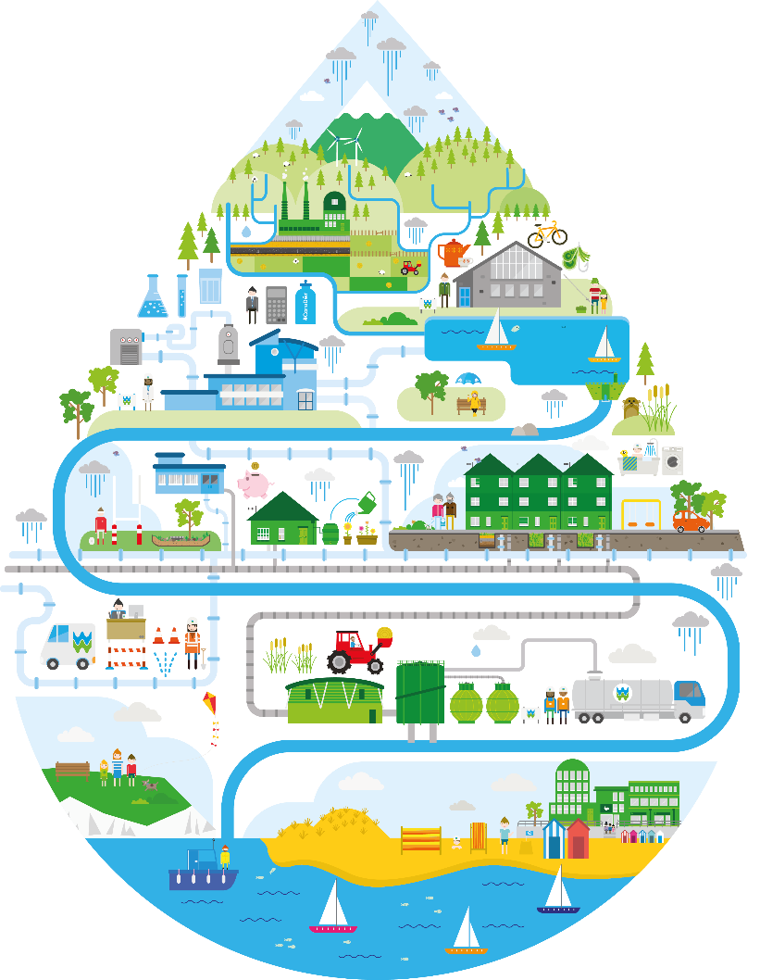
WELSH BACCALAUREATE
Key Stage 4 National/Foundation
Global Citizenship Challenge

Slide 2
Contents
Who we are
What’s the problem?
What is RainScape?
RainScape in action
- Challenges
- Customers and Partnerships

Slide 3
Who we are
- 4th biggest company in Wales,
- a ‘non-shareholder’ company which is unique in the water industry
- all gains reinvested to improve services and keep customer bills affordable
- serve 1.4 million household and business customers in Wales, Herefordshire and parts of Deeside
- deliver industry leading levels of performance for environment and customer service

Slide 4
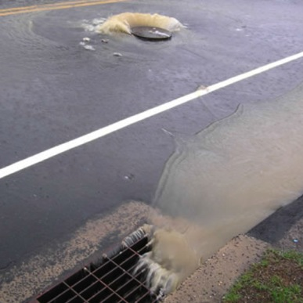
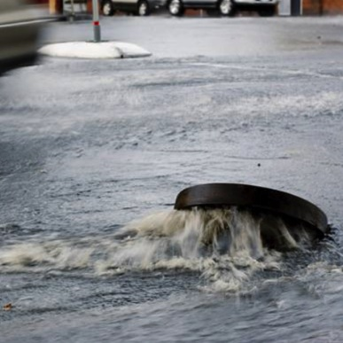
What’s the problem?
High levels of rainfall cause issues such as:
- sewer flooding in residential areas
- excessive spills from network to environment
- restraints on building new homes
Llanelli - network has as much storm water as Swansea - despite Swansea serving three times as many properties

Slide 5
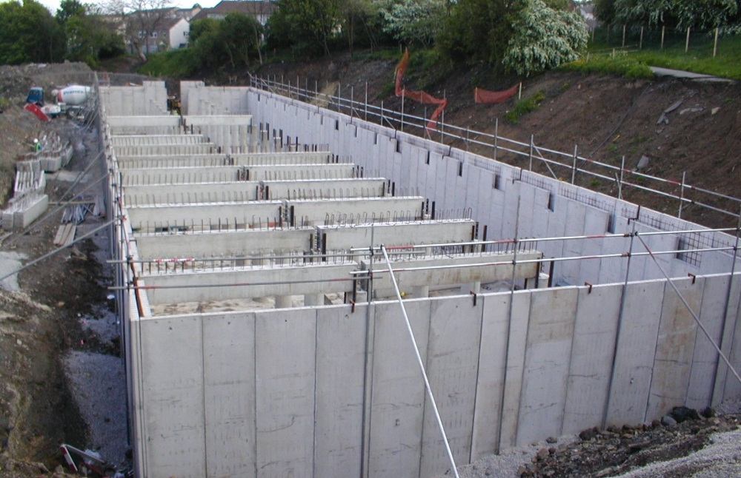
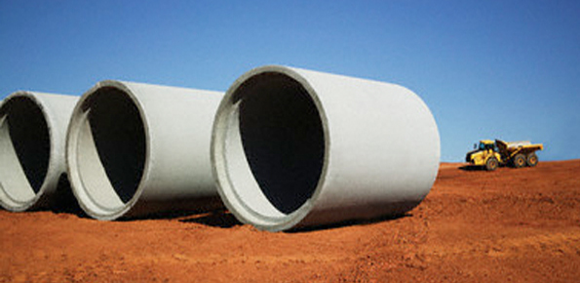

Traditional approach storage – not feasible, not affordable
£600m

Slide 6

RainScape – the sustainable alternative
- Uses tried and tested methods from around the world
- Climate change, “urban creep”, flooding risk
& economic development needs
- 2015-2020 target: equivalent run-off from 25,000
rooftops in Wales

Slide 7
The Story of RainScape

Slide 8
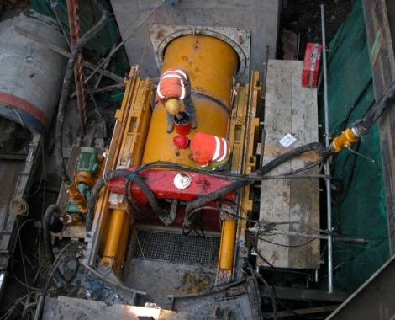
Installation Progress - ongoing
Tunnel
Carway Street, Burry Port
Started May 2015
Planned to completed February 2015
£2m investment
8 home to be removed from sewer flooding register
Tunnelling under railway to Gors Road completed July 2015

Slide 9
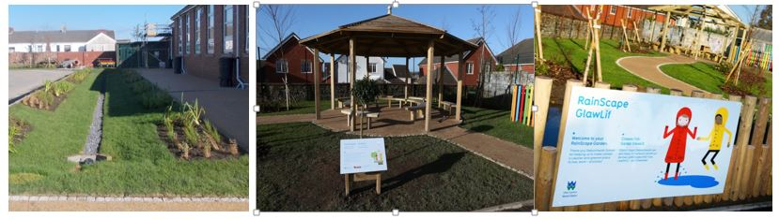
RainScape in action - Stebonheath School

Slide 10
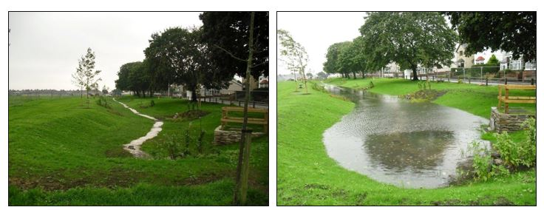
RainScape in action - Queen Mary’s Walk swale

Slide 11
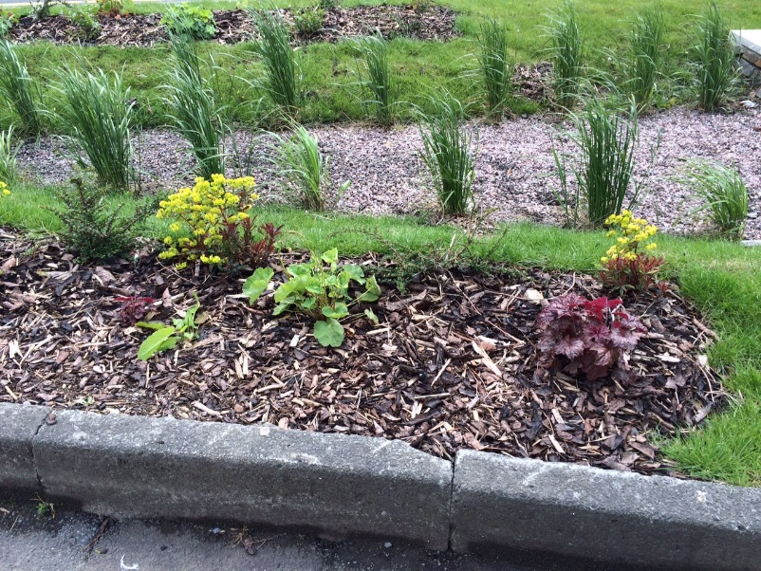
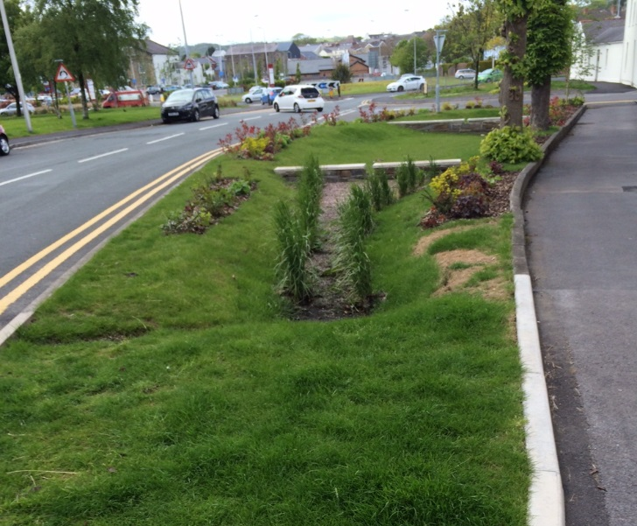
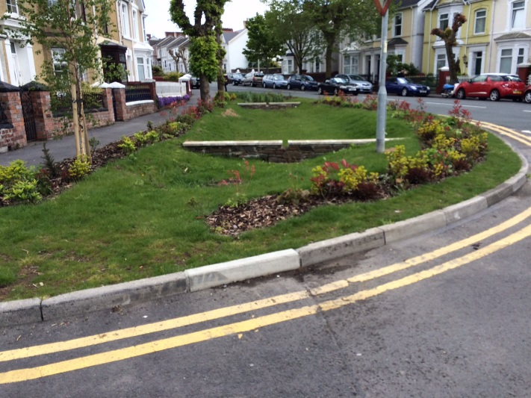
RainScape in action - Glevering Street

Slide 12
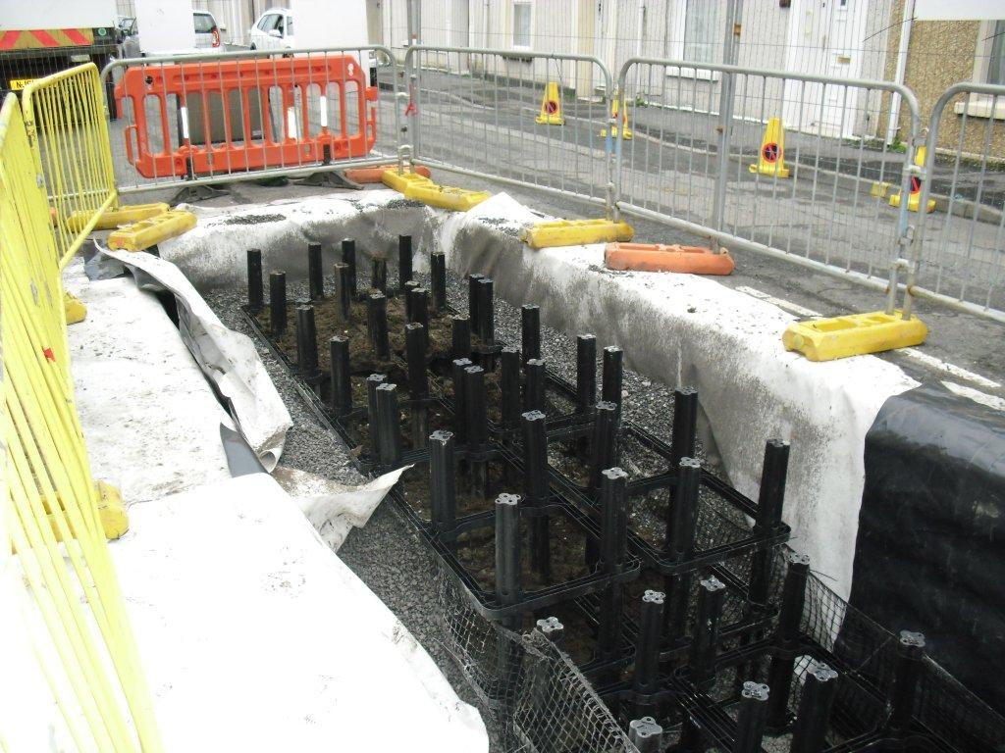
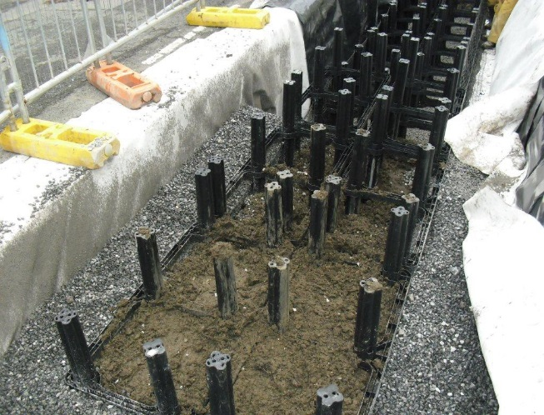
RainScape in the ground

Slide 13
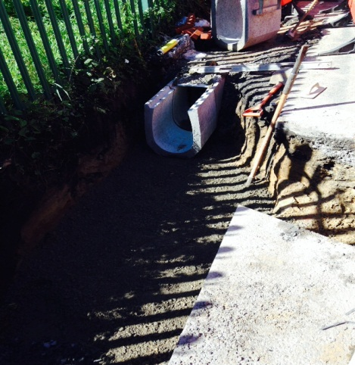
RainScape in the ground

Slide 14
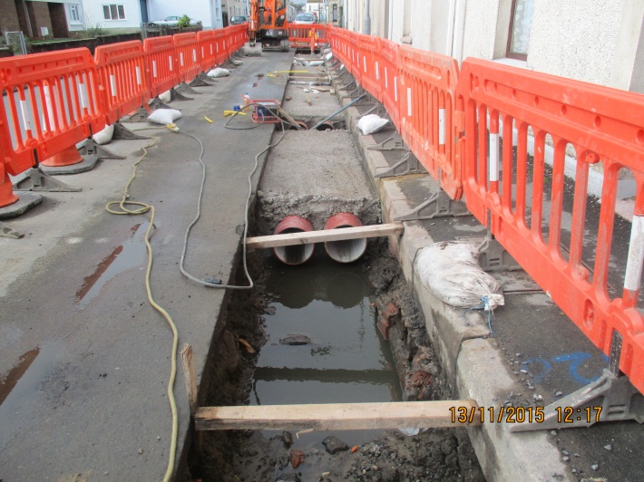
RainScape in the ground

Slide 15
How well is it working?
Monitoring installed
Working better than expected
Improving over time
Learning from early schemes to improve programme e.g. planting

Slide 16
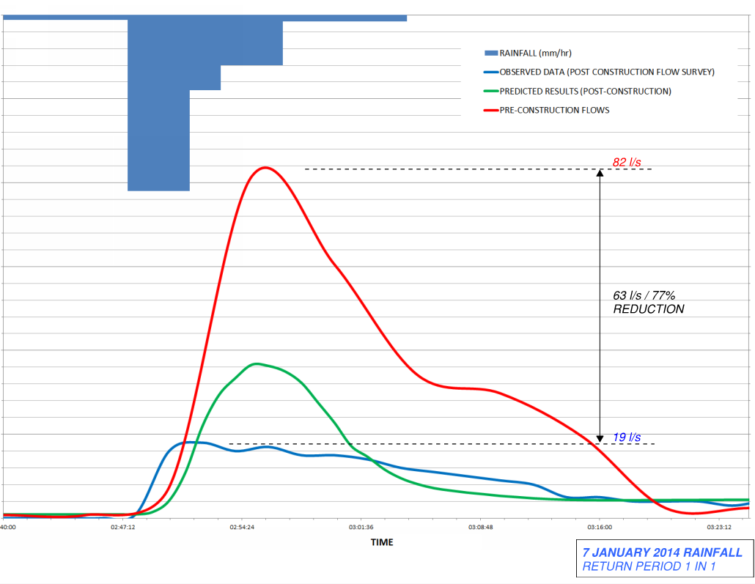
Improving performance – Jan 2014
Flow (l/s)
Rainfall (mm/hr)

Slide 17
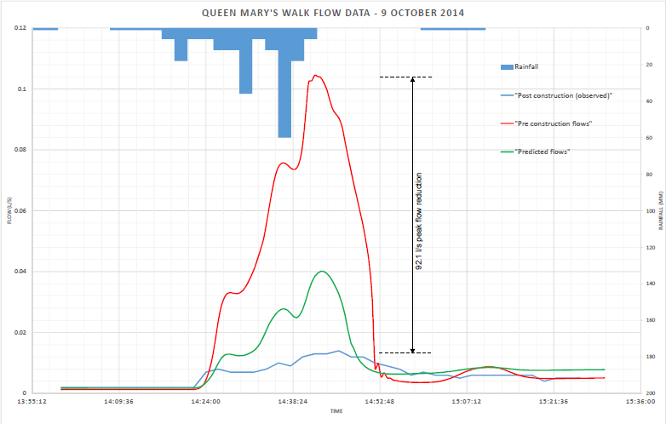
Improving performance – Oct 2014
Flow (l/s)
Rainfall (mm/hr)

Slide 18
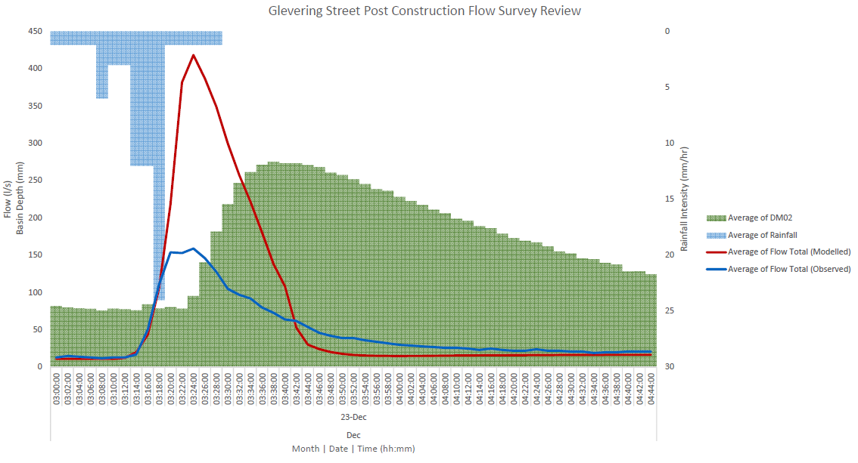
Performance – Glevering Street
Notes:
First data available
Dec 23 – 1 in 6 month storm
Achieved > 250l/s flow reduction
Ahead of design target
New planting will improve performance further
Effect is greater than combined Stebonheath and Queen Mary’s Walk

Slide 19
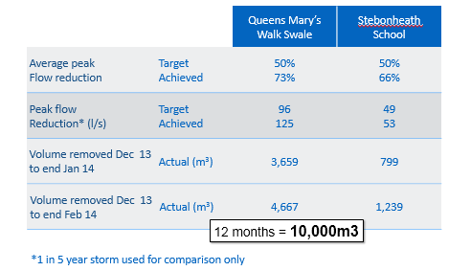

Slide 20
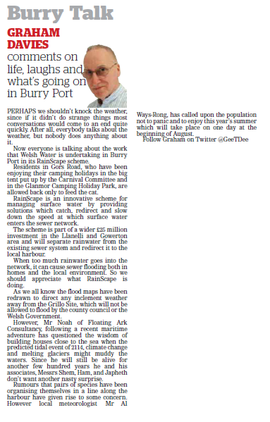
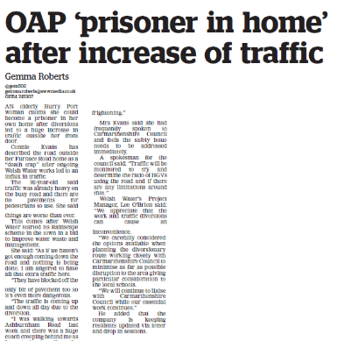
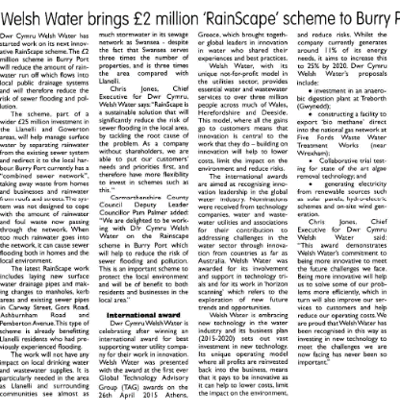
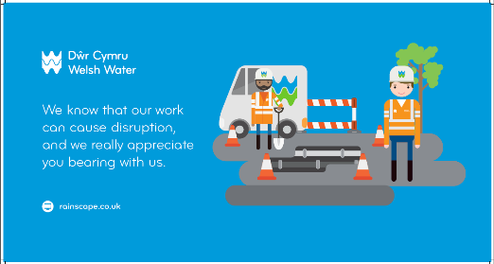
Communications to date
Liaised with over 5,000 customers
Hosted 7 info events and 15 drop-in surgeries
Issued over 19,000 letters/newsletters
Around 45 home visits
Over 1,700 doors knocked
RainScape at the Hub, opened April 2015
Burry Port Carnival (July 2015)
Regular drop-in sessions at Burry Port Library
Facilitation Group with Carmarthenshire Council
Highways Authorities and Utilities Committee

Slide 21
EIB film

Slide 22

Diolch / Thank you

